Slide 1
An Introduction to Android Development
Basics, Technical Constructs and Practices.

Slide 2
Before We Start, make sure….
You have taken a recent pull of the Bootcamp app from https://github.com/androidbootcamp/Android-Bootcamp-V1.1 and checkout Day_3 branch.
Skeleton app is running properly in your device.

Slide 3
What we did ….
Intents
Database Handling

Slide 4
Agenda
AdapterViews
Adapters
SimpleListAdapters
CustomArrayAdapters
Themes
Hierarchy Viewer (Demo)

Slide 5
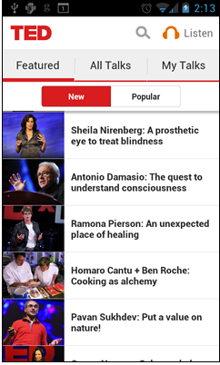
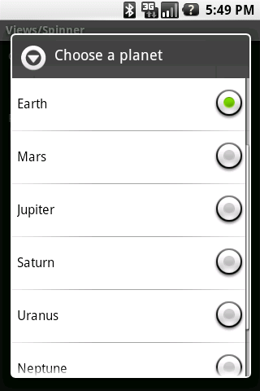
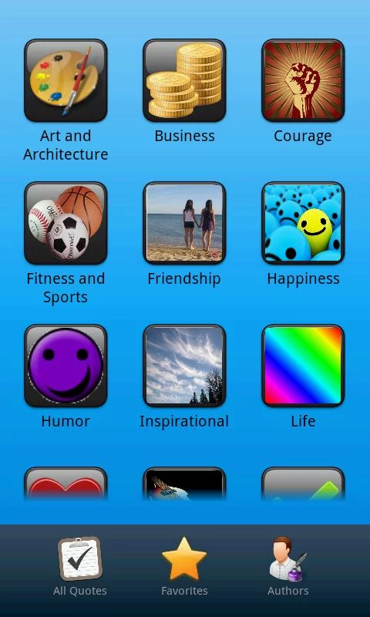
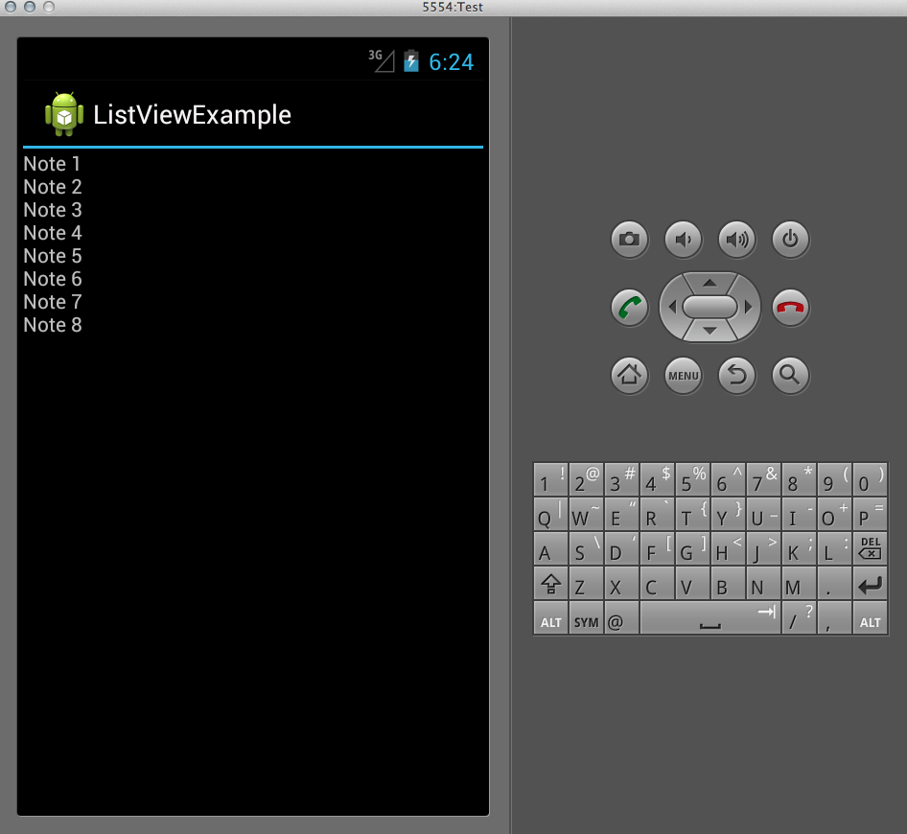
AdapterViews

Slide 6
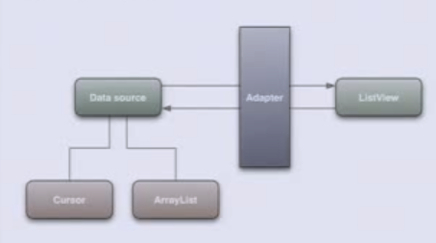

Adapters
What are adapters?
Need
Data Source
Adapter
ListView
Cursor
ArrayList

Slide 7
Assignment 7
Design a shopping application using Grid View
Use Array adapters

Slide 8
ArrayAdapter
To use ArrayAdapter
ArrayAdapter<String> adapter = new ArrayAdapter<String>(context, resource ID of a view to use, actual array/list of items);

Slide 9
Custom Array Adapter

Slide 10
Custom Array Adapter
public abstract getView (int position, convertView, parent)

Slide 11
Assignment 8
Customize a shopping application using Custom Adapters

Slide 12
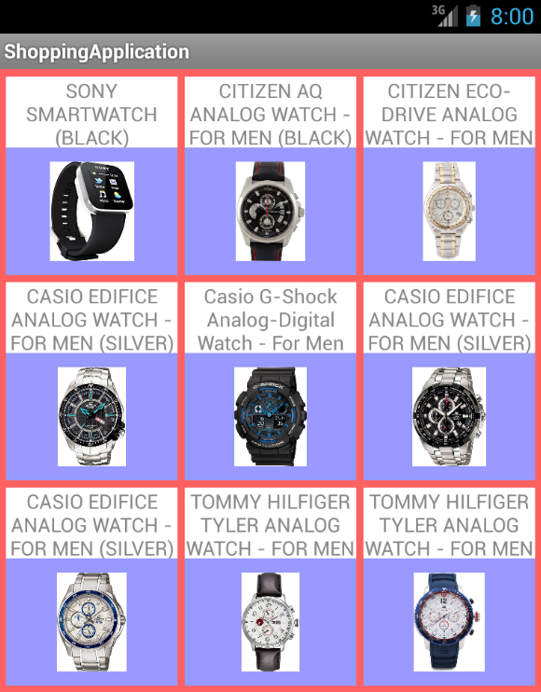
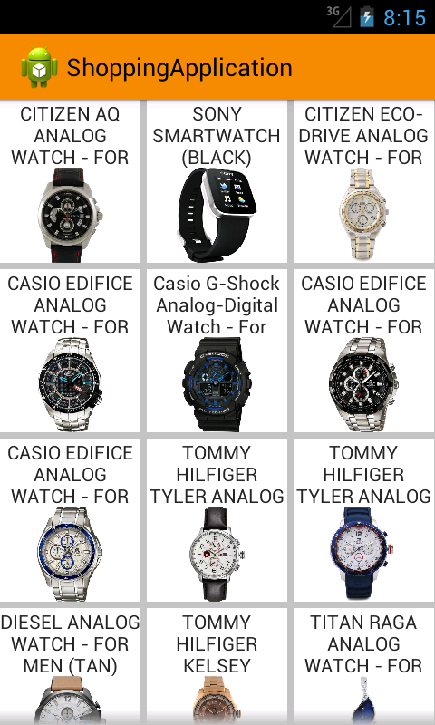
Introduction To Themes

Slide 13
Assignment 9
Apply default themes in shopping application

Slide 14
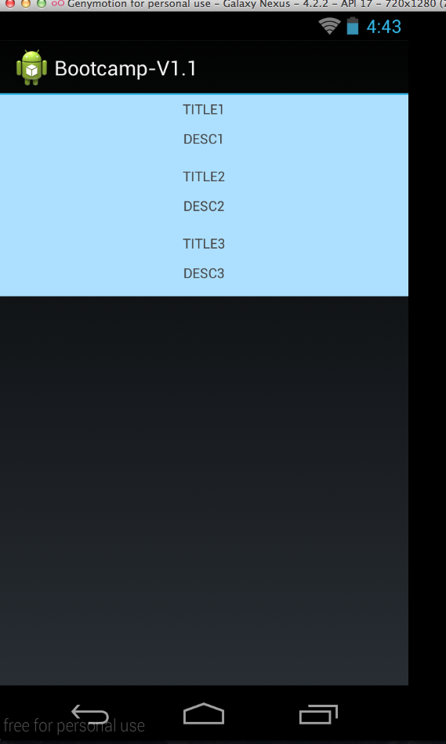
Final …

